Slide 1
Poliomyelitis and Acute Flaccid Paralysis Surveillance
Dr. W.I.U Jayawickrama
Senior Registrar/ Community Medicine

Slide 2
A highly infectious neurological disease manifesting with acute flaccid paralysis by polio virus
Poliovirus has 3 subtypes P1, P2, P3
Transmitted via faeco-oral route
Virus enters the blood stream from the GI tract and attacks the motor neurons causing paralysis
asymmetrical paralysis & leaves a residual disability

Slide 3
Occurs at any age but mainly targets <5 years
Virus is shed intermittently for 1 month after infection and is maximum during 1st two weeks
Does not survive long in the environment outside the human body & is rapidly inactivated by heat, formaldehyde, chlorine and ultra violet light
Polio cases by WPV type 2 last reported in 1999

Slide 4
Reservoir – Only humans
Incubation Period- 10-21 days
Sex distribution- 1962- 1993 Sri Lanka
Male: 56.7% Female:43.3%
Age distribution- 1962- 1993 Sri Lanka
< 1 year – 17.2%
1-4 years -68.8%
5-9 years- 10.6%
> 10 years- 3.4%

Slide 5
Clinical Features
>90% - silent or present as non specific fever
4-8% -minor illness (Abortive poliomyelitis) – Fever, malaise, headache, nausea and vomiting
1% - Aseptic meningitis
1% - Flaccid paralysis

Slide 6
Laboratory Diagnosis
Isolation of Polio virus in the stool specimen:
Virus is excreted via stool from an infected person. Two stool specimens should be collected 24-48 hours apart soon after diagnosis. Ideally within one to two weeks of onset of paralysis
Quantity: 6-8 grams ( Approximately size of two tamarind seeds or two adult thumb nails
Timely collection, storage and proper transport are crucial for lab diagnosis.

Slide 7
1988 1000 polio children per day 125 polio endemic countries
2000 10 polio children per day 20 polio endemic countries
2015 1-2 Polio children per week 2 polio endemic countries
Pakistan
Afghanistan

Slide 8
Important milestones of Poliomyelitis in Sri Lanka
1944 - Poliomyelitis was made a notifiable disease
1962 - First major epidemic (1810 cases,180 deaths) and several outbreaks after that
1962 - Introduction of OPV to Colombo & suburbs for children aged 3 months -15 years
1978 - Expanded Programme of Immunization (EPI) implemented
1990 – Acute Flaccid Paralysis (AFP) was made a notifiable disease

Slide 9
1991 - Case based investigation of AFP cases
1993 - Last virologically confirmed case of polio
1995-2000- National Immunization Days : additional OPV dose to <5 year age group
2001-2003- Sub National Immunization Days and mopping up campaigns
1993 to date no polio cases in Sri Lanka
Source: Epidemiology Unit

Slide 10
Immunization of High Risk Groups
National Immunization Days: all Island
from 1995 – 2000
Sub-National Immunization Days [SNID], North and East districts
from 2001-2003
Mopping up Immunization Programmes
1993 – Puttalam District
1994 – Trincomalee District
from 2001-2003 – Northern and Eastern Districts

Slide 11
Reasons to Conduct SNIDs in North and East
Immunization coverage is relatively low
Population is in transit
Hard to reach communities
High population density in urban areas

Slide 12
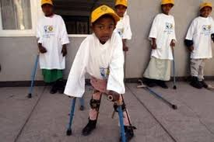
Certification of Polio Eradication
Global polio free certification of Eradication: 2018
South East Asia (Our Region): Certification of polio free certification plan: February 2014

Slide 13
Main strategies of Polio Eradication
Strong Routine Immunization Program – High uniform coverage with OPV
Supplementary Immunization Activities-SIAs (NID/SNID) [Immunize children <15 yrs of age among returnees from South India]
Mop Up campaigns– intensive immunization campaigns in the last remaining foci of transmission
AFP Surveillance – to detect possible polio cases

Slide 14
Polio Immunization Policy in National Programme
1st Dose – at completion of 2 months of age
2nd Dose – at completion of 4 months of age (+IPV)
3rd Dose – at completion of 6 months of age
4th Dose – at completion of 18 months of age
5th Dose – at completion of 5 years of age

Slide 15
AFP surveillance
What is AFP Surveillance
Why AFP Surveillance is carried out
Role of hospital staff & public health staff in AFP Surveillance

Slide 16
What is A.F.P case
Acute - Sudden onset, Rapid progression
Flaccid - Floppy or Soft and yielding to passive stretching at anytime during the illness
Paralysis - is loss of muscle strength / weakness, loss of voluntary movement
AFP is a syndrome of specific signs and symptoms found in a number of diseases, including Polio.

Slide 17
In the Global Polio Eradication Initiative (PEI), acute flaccid paralysis is defined as:
Any case of Acute Flaccid Paralysis in a child aged <15 years
(including those diagnosed as having Guillain Barre Syndrome or Infective polyneuritis or any other condition), or
any case of paralytic illness in a person of any age when polio is suspected.

Slide 18
Differential diagnosis of AFP
Upper Motor Neuron Disorders
Transverse/Ascending myelitis
Encephalitis/Encephalomyelitis
Stroke
Cerebral tumours

Slide 19
Lower Motor Nuron Disorders
Anterior Horn Cell:
-Acute Poliomyelitis
-Non- polio virus induced paralysis (esp enteroviruses)
-Vaccine Associated Paralytic Poliomyelitis (VAPP)
Root: Acute radiculopathies
Plexus: Brachial neuritis
Nerve: Guillain- Barre’ Syndrome, Toxin induced neuropathies, Acute Intermittent Porphyria, Tick paralysis, Diphtheritic neuropathy

Slide 20
Neuro-muscular Junction:
Myesthenia gravis
Snake bite
Poisoning
Botulism
Muscle:
Post viral myositis,
Polymyositis/dermatomyositis,
Periodic paralysis

Slide 21
Responsibility of Hospitals
Notify all AFP cases under 15 years immediately to Epidemiologist, RE & ICNO
Complete EPID form no.1 (pink form) & send to Epidemiology Unit
Collect 2 samples of stools 24 – 48 hours apart within 14 days of onset of paralysis
8 -10g each
To clean dry screw capped containers
Packed in ice and send to MRI
To be refrigerated till dispatch
Transport to MRI within 3 days of collection

Slide 22
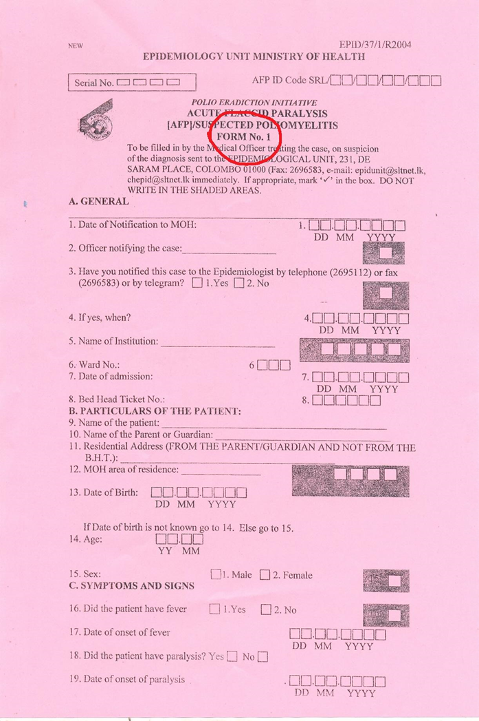

Slide 23
Request form accompanying the Patient’s Samples including details of
Name, Age & sex of the patient
Name of the hospital, ward and BHT number
Date/s of collection of the sample/s
Brief clinical history
Last date of immunization

Slide 24
Responsibility of Medical Officers of Health
Collect a single sample of stools from each contact (3 -5)
8 -10g each
To clean dry screw capped containers
Packed in ice
To be refrigerated till dispatch
Transport to MRI within 3 days of collection
Immunize a maximum of 250 children in a radius of 1-2 Km with 1 dose of OPV
Complete and send the Yellow form to Epidemiology Unit

Slide 25
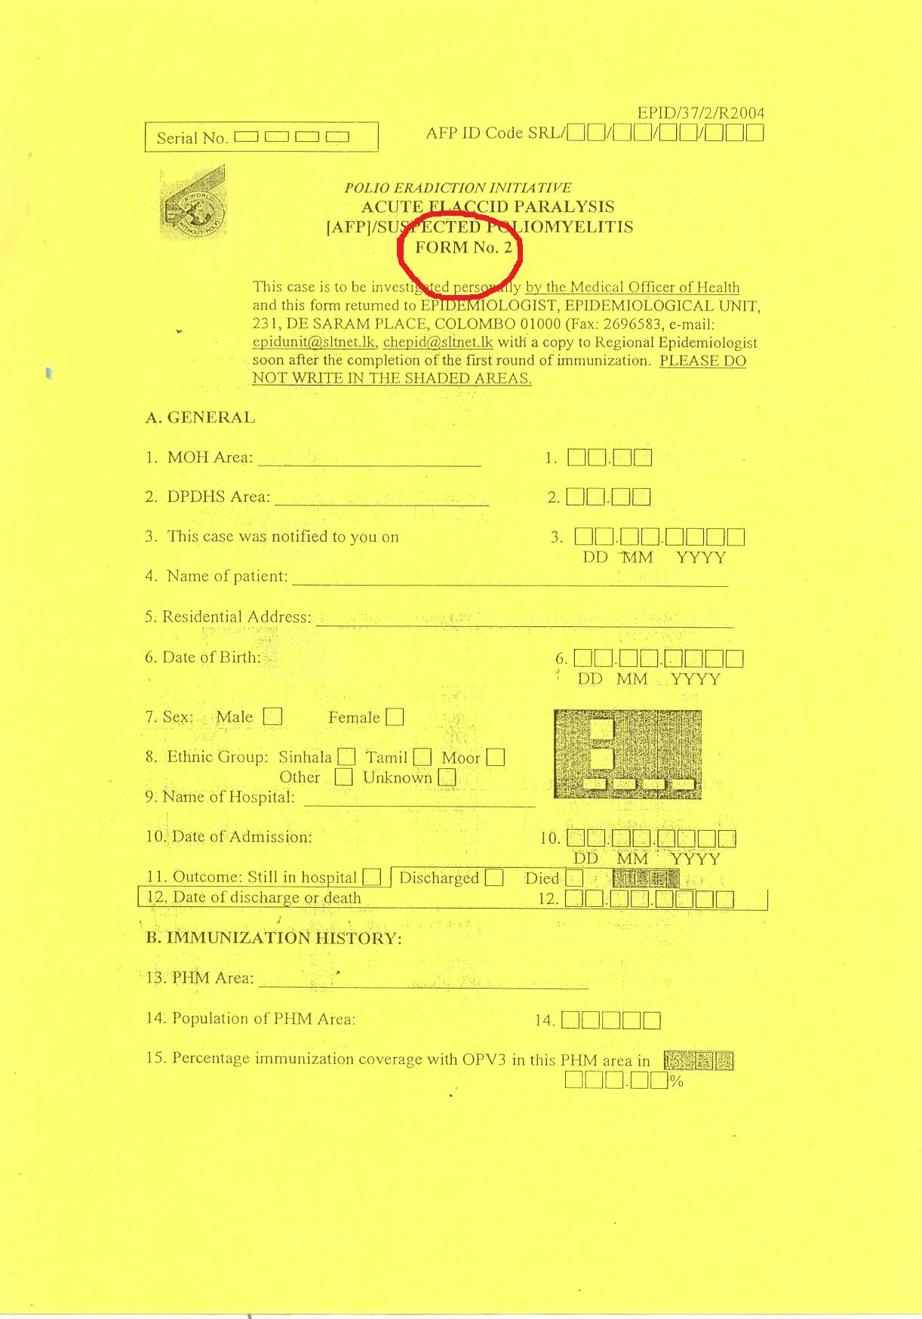

Slide 26
Responsibility of RE
Active surveillance of sentinel sites : at least 2 weekly
Visit sentinel site hospitals
Talk to peadiatricians and physicians
Maintain AFP, Measles, Rubella,CRS registers
All AFP patients reported to be informed to relevant MOH and relevant REE , if in other districts
Follow up to send contact stool samples to MRI
60 day follow up, continue 90 and 120 days follow up in need

Slide 27
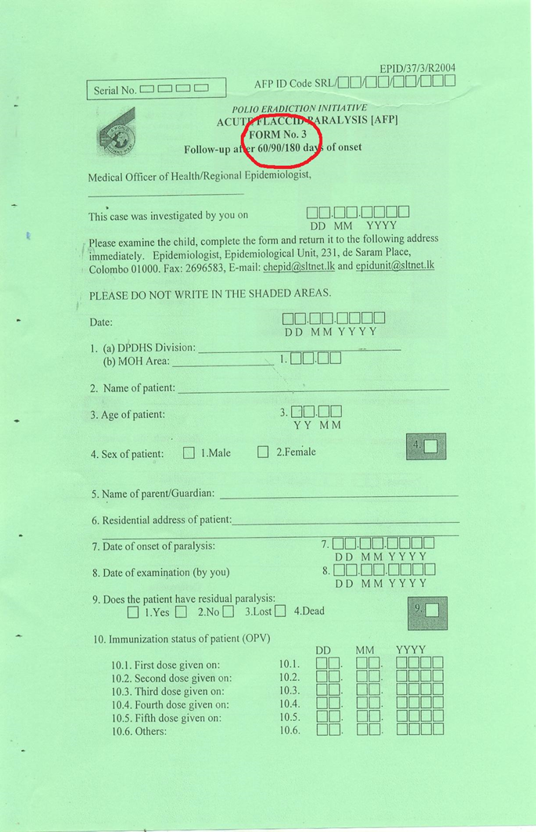

Slide 28
Importance of AFP surveillance
To identify any potential outbreaks and manage them effectively.
strengthened sentinel sites AFP surveillance
Notification of all AFP cases <15 years presented to sentinel sites
Laboratory exclusion of the presence of polio virus, within 14 days of the onset of paralysis
2 stool samples to be collected in adequate amount (6-8g) in 24-48hrs apart within 14 days of onset
Screen contacts and exclude transmission
Strengthen population immunity: additional OPV dose
Maintain Polio free certification: to meet national targets

Slide 29
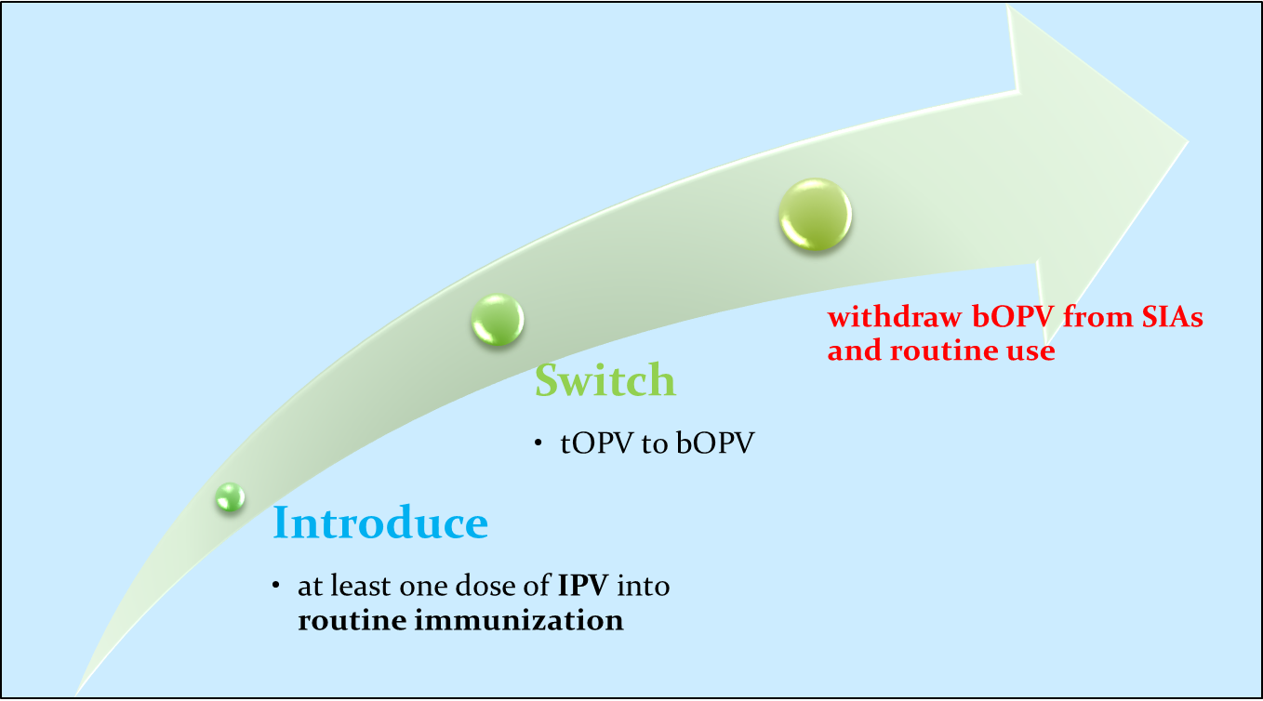
Polio Eradication Endgame plan- three distinct stages (Source: Epidemiology Unit)

Slide 30
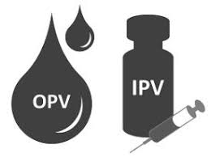
Sri Lanka
Add IPV one dose as an additional dose :2015 with the 2nd dose of OPV -1st July 2015
Shifting over from tOPV to bOPV : 30th April 2016
Total shifting over with Global polio eradication and recommendations of complete shifting over to IPV

Slide 31
Polio cases become zero due to high coverage of OPV vaccination in all districts through out the country
Active surveillance of all paralyzed cases (<15 years) ensures no more cases of Poliomyelitis in the country after 1993
Sri Lanka also heading for Polio Eradication with global strategies

Slide 32


